Slide 1
Welcome to Marketing Management
Dr. Cecilia Ruvalcaba
BUSI 107 Week 11, Day 3

Slide 2
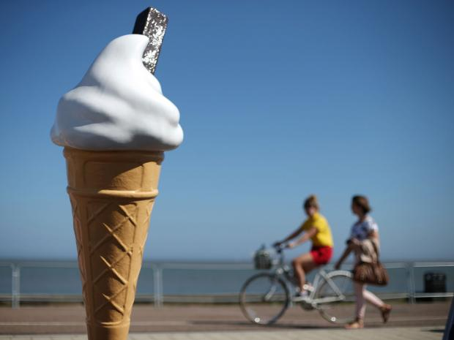

Notes:
Dessert Makers Trying To Cope As Price Of Vanilla Beans Shoots Up
http://sacramento.cbslocal.com/2016/04/08/dessert-makers-trying-to-cope-as-price-of-vanilla-beans-shoots-up/
Fiat Chrysler to Cut 1,300 Jobs at Michigan Sedan Factory
http://www.wsj.com/articles/fiat-chrysler-to-cut-1-300-jobs-at-michigan-sedan-factory-1459962002

Slide 3
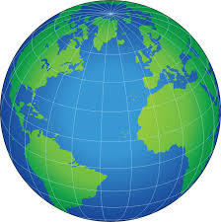
Global Markets

Slide 4
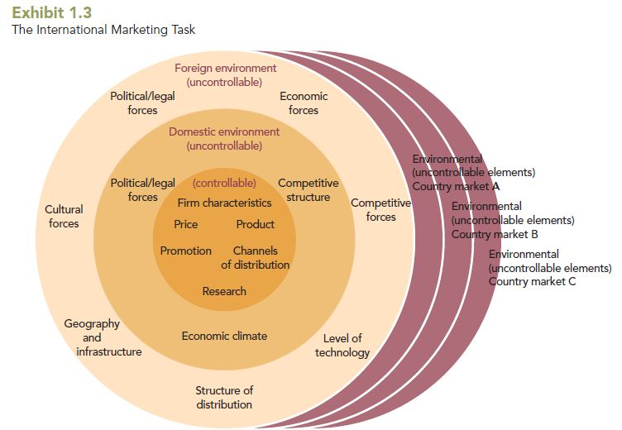
The International Marketing Task

Slide 5
Economic Development
Advanced economies: Post-industrial countries with high per capita income, competitive industries, and developed commercial infrastructure. Typically the richest countries, including Australia, Canada, Japan, U.S., and nations of Western Europe.
Emerging market economies: Former developing economies that achieved substantial industrialization, modernization, and remarkable economic growth.
Upper-Middle-Income Countries: Countries that are experiencing rapid economic expansion and industrialization such as Chile, Brazil, Mexico, South Korea, Singapore, and Taiwan
Lower-Middle-Income Countries: Industrially developing countries just entering world trade, many of which are in Asia and Latin America, with relatively low per capita incomes.
Developing economies: Low-income countries characterized by limited industrialization and stagnant economies.

Slide 6
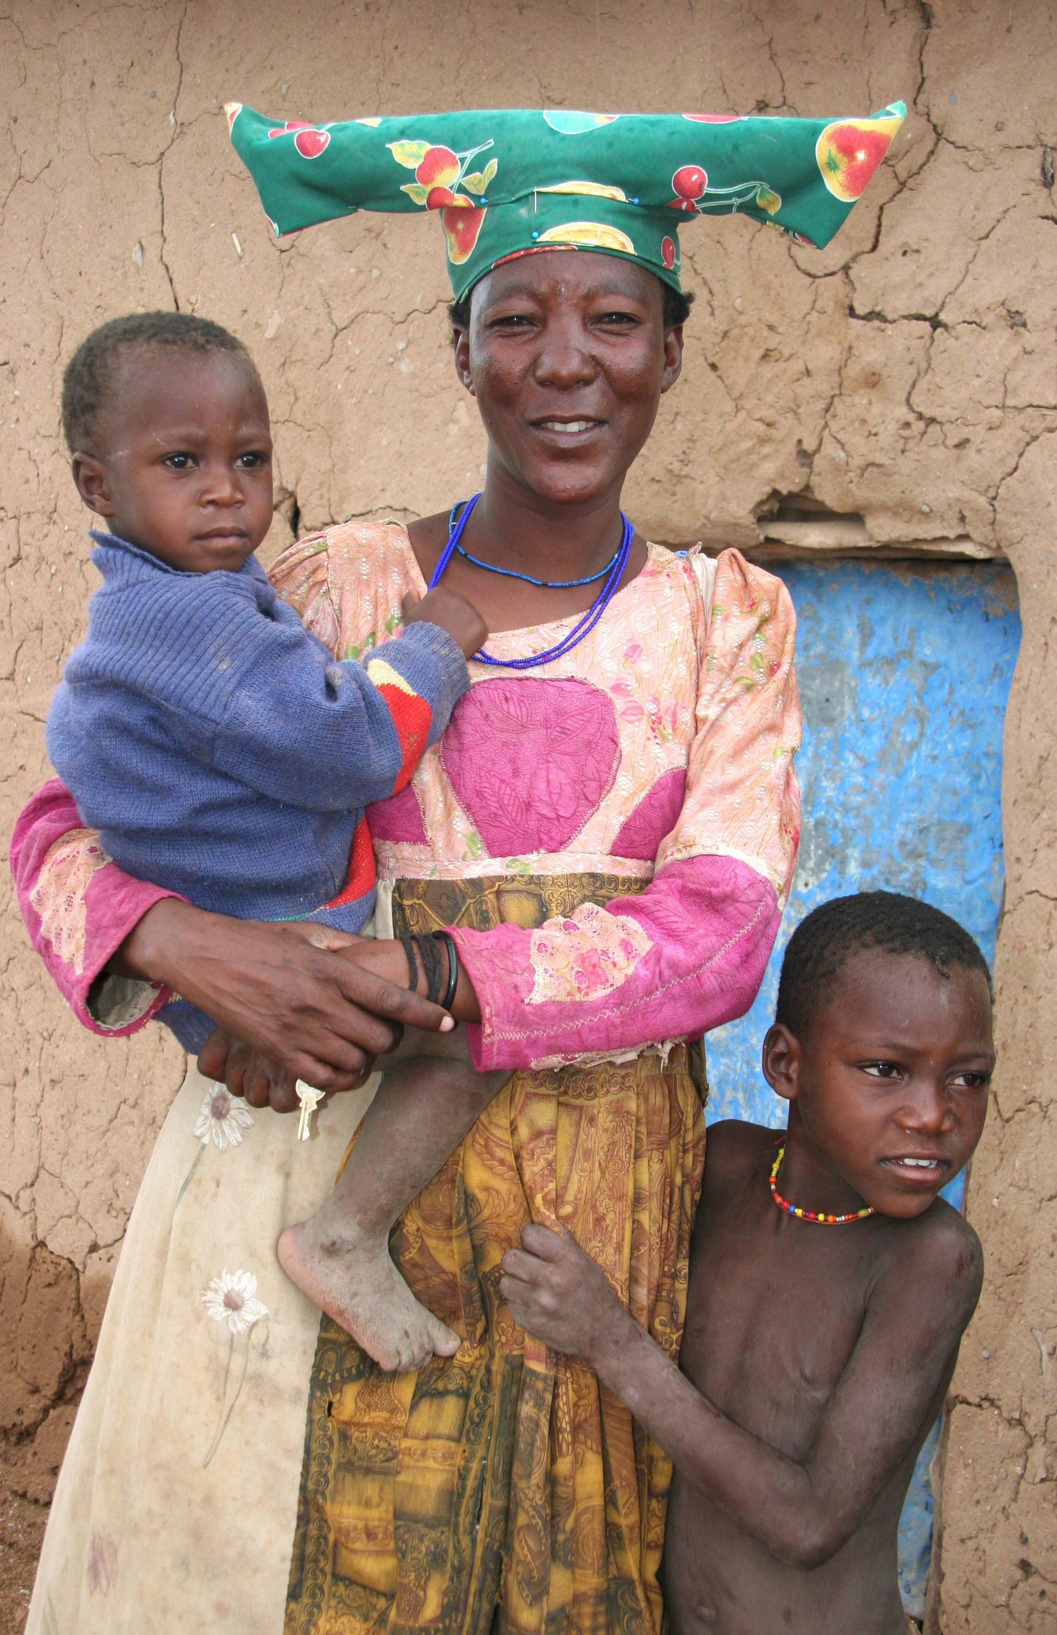
Low-Income Countries
GNI per capita of $996 or less
Characteristics
Limited industrialization
High percentage of population in farming
High birth rates
Low literacy rates
Heavy reliance on foreign aid
Political instability and unrest
Concentrated in Sub-Saharan Africa

Slide 7
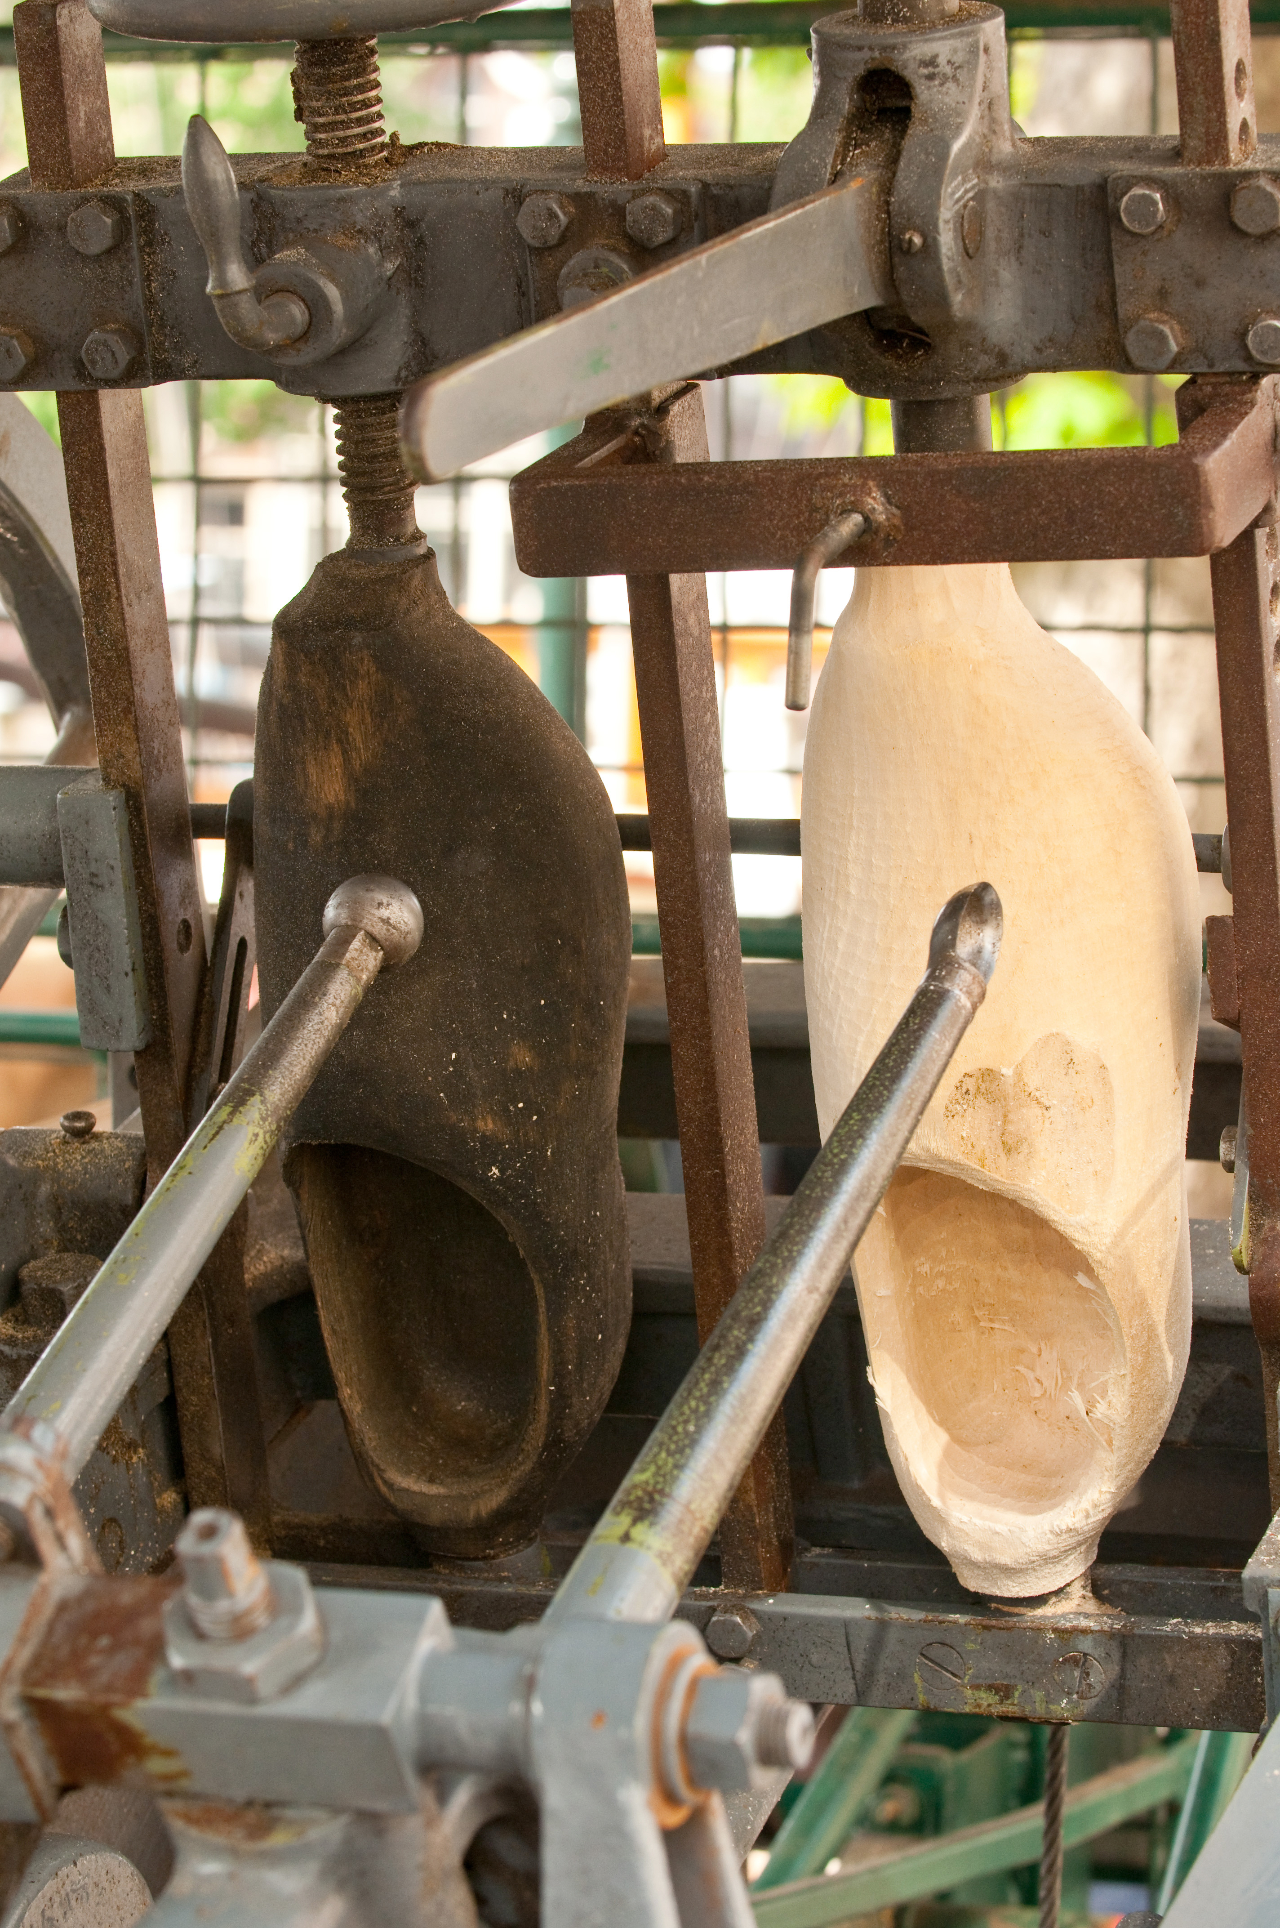
Emerging Markets: Lower-Middle-Income Countries
GNI per capita: $996 to $3,945
Characteristics
Rapidly expanding consumer markets
Cheap labor
Competitive advantage in mature, standardized, labor-intensive industries like footwear, textiles and toys
BRIC nations are India GNI $1,180, China GNI $3,590

Slide 8
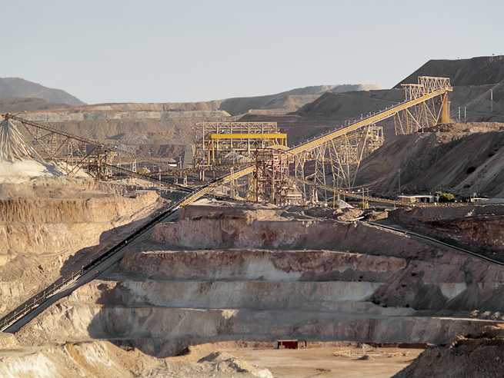
Emerging Markets: Upper-Middle-Income Countries
GNI per capita: $3,946 to $12,195
Characteristics:
Rapidly industrializing, less agricultural employment
Increasing urbanization
Rising wages
High literacy rates and advanced education
Lower wage costs than advanced countries
Examples: Brazil, Russia, Malaysia, Chile, Venezuela, Hungary, Mexico

Slide 9
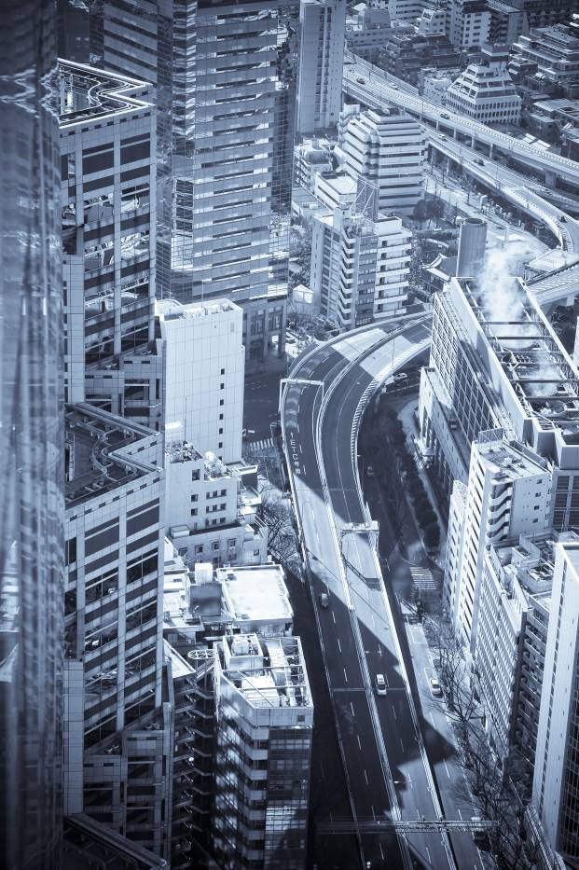
High-Income Countries
GNI per capita: $12,196 or more
Also known as advanced, developed, industrialized, or postindustrial countries
Characteristics:
Sustained economic growth through disciplined innovation
Service sector is more than 50% of GNI
Households have high ownership levels of basic products
Importance of information processing and exchange
Ascendancy of knowledge over capital, intellectual over machine technology, scientists and professionals over engineers and semiskilled workers
Future oriented
Importance of interpersonal relationships

Slide 10
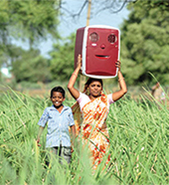
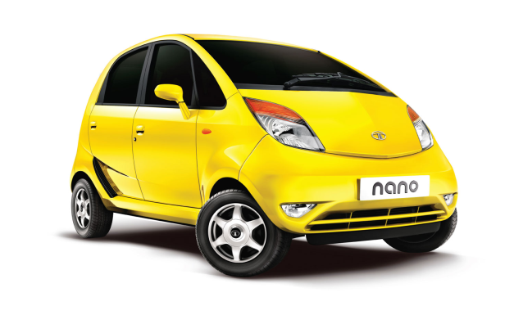
Bottom of the Pyramid Markets (BOP)
4 billion people
$1,200 annual income
Dispersed across countries
Relatively ignored by marketers
The poor have no money
The poor do not want to “waste” money on nonessential goods.
The good sold in developing markets are already inexpensive.
They do not know how to use technology
Global companies are exploiting the poor

Slide 11


Take Away for Today
Global Marketing vs. Marketing… It’s in the Scope
It’s all about innovation!
Opportunities lie where you may least expect it!

Slide 12

Next Class
Chapter 18: Integrated Marketing Communications

